Slide 1
Shell Bootcamp 2024 3 Reflections for Week #<>
<Name>
Date : 30-Aug-2024

Slide 2
About Me
Two steps forward and one step back is still one step forward.
Please share an image / visual that best represents you

Slide 3

My learnings from this week!

Slide 4
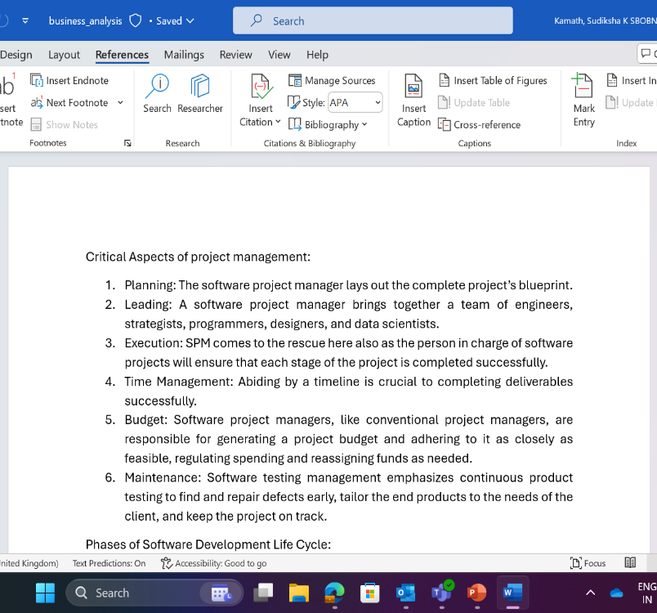
Learning 1 | My takeaways
I learnt about the various aspects of Business Analysis, including understanding the functions of a Business Analyst, conducting requirement analysis, eliciting and managing requirements. We also delved into the critical aspects of project management and the different phases of the software development life cycle. In the energy sector these are valuable as they help ensure projects are well-planned, meet stakeholder needs, and adhere to industry standards, leading to better solutions.

Slide 5
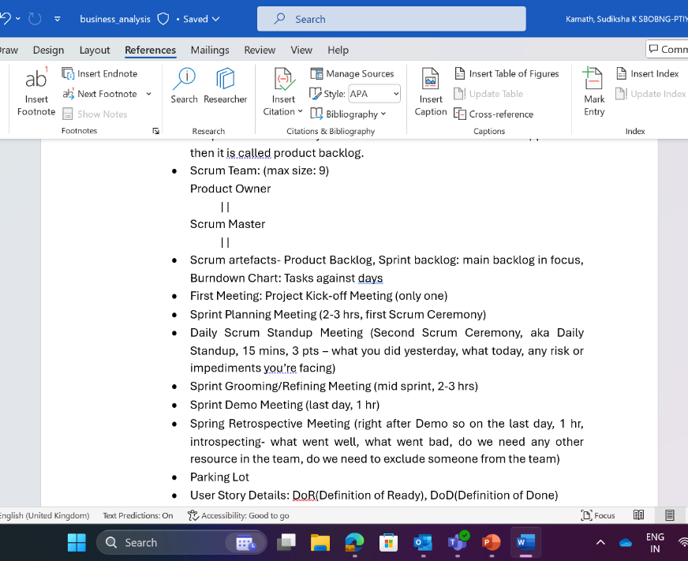
Learning 2 | My takeaways
I learnt about team work in the activity that we did where we did the Business Requirement Document and Software Specification Document. We also learnt about the different SDLC models like waterfall, agile, prototype and scrum.

Slide 6
Learning 3 | My takeaways
Please share (in your own words) details of the learning.
Key learning
Key takeaway
How do I personally see this concept implemented in the Energy sector
[Add a graphic that provides evidence of what you learned]

Slide 7

Relevance of learnings for my organization

Slide 8
Learning 1 | Relevance for Shell
How I feel Shell implements this learning (in your own words)
How I feel Shell benefits from this learning (in your own words)
[Add a graphic that provides view of how Shell implements this learning]

Slide 9
Learning 2 | Relevance for Shell
How I feel Shell implements this learning (in your own words)
How I feel Shell benefits from this learning (in your own words)
[Add a graphic that provides view of how Shell implements this learning]

Slide 10
Learning 3 | Relevance for Shell
How I feel Shell implements this learning (in your own words)
How I feel Shell benefits from this learning (in your own words)
[Add a graphic that provides view of how Shell implements this learning]

Slide 11

Challenges in implementing learning

Slide 12
Challenge faced while implementing Learning 1
What were the challenges I faced while implementing Learning 1 and my plan to overcome them
GitHub link of your solution/documentation
[Add a graphic that provides evidence of what you did to overcome this challenge]

Slide 13
Challenge faced while implementing Learning 2
What were the challenges I faced while implementing Learning 2 and my plan to overcome them
GitHub link of your solution/documentation
[Add a graphic that provides evidence of what you did to overcome this challenge]

Slide 14
Challenge faced while implementing Learning 3
What were the challenges I faced while implementing Learning 3 and my plan to overcome them
GitHub link of your solution/documentation
[Add a graphic that provides evidence of what you did to overcome this challenge]

Slide 15

Action Plan

Slide 16
My Action Plan for this Week
Actions
Timeline
Status
Details of actions planned for the new lrearning or overcoming the challenge
The planned timeline to implement the actions
Status of the same by the end of the week

Slide 17

Learning is also Fun!

Slide 18
Learning is also Fun!
Please share how ”Your” learning was fun this week
Details of any group activity
Details of any funny incident which had an element of new learning for this week’s topic
[Add a graphic or a picture of how you/your team enjoyed the new learning]

Slide 19

Summary
Quick summary
Importance of topics of upcoming week
Connectivity of topics from current week

Slide 20
Thank You

